Slide 1

Grocery Store Management
Presented By :
Pattan Reshma

Slide 2
AGENDA
INTRODUCTION
BUSINESS PROBLEM
BUSINESS OBJECTIVE
DATABASE EXPLAINATION
ER DIAGRAM
KEY ANALYSIS QUESTIONS
KEY INSIGHTS
CHALLENGES AND EXPERIENCE
CONCLUSION

Slide 3
INTRODUCTION
The Grocery Store Management focuses on analysing the sales performance of a grocery store by managing data related to customers, products, suppliers, employees, orders, and order details. Using SQL queries, the project generates business insights that help improve sales performance and support better business decisions.

Slide 4
BUSINESS PROBLEM
A grocery store generates a large number of sales transactions every day. As the amount of sales data increases, it becomes difficult to manually track customer purchases, identify best-selling products, monitor monthly sales trends, and evaluate employee performance. Without proper analysis, the business cannot make effective decisions to improve sales and profitability.

Slide 5
BUSINESS OBJECTIVE
The objective of this project is to analyze the sales performance of the grocery store using SQL by identifying customer purchasing behavior, best-selling products, monthly sales trends, supplier contributions, and employee performance to support data-driven business decisions.

Slide 6
DATABASE INFORMATION
Table Name | Description
supplier | Stores information about the suppliers who provide products.
categories | Contains the different product categories (e.g., Beverages, Snacks).
employees | Records employees responsible for handling customer orders.
customers | Contains customer details who place orders.
products | Holds product information, including price, supplier, and category.
orders | Logs customer orders handled by employees.
order_details | Stores line items for each order, including product quantity and pricing.

Slide 7
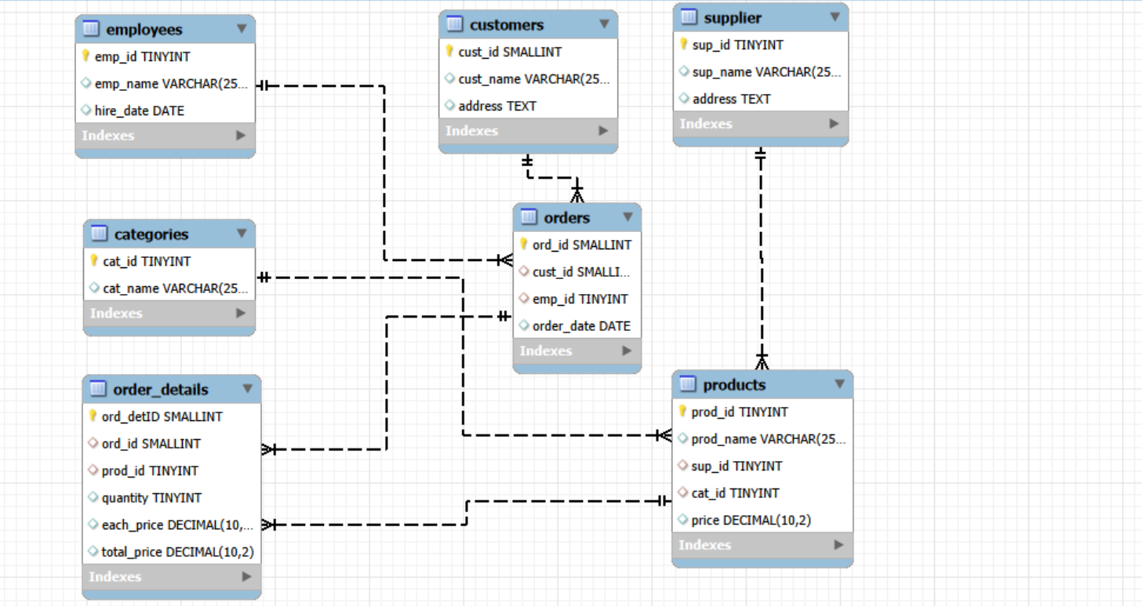
ER DIAGRAM

Slide 8
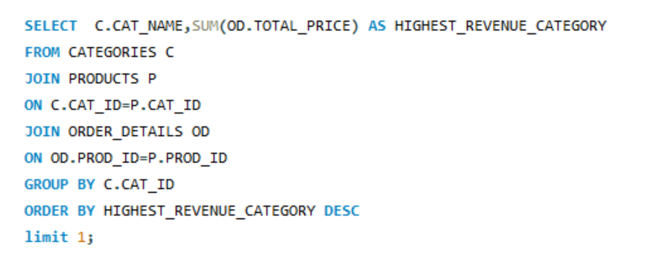
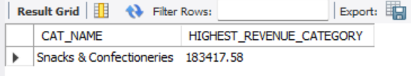
KEY ANALYSIS QUESTIONS
Which category generated the highest sales revenue?

Slide 9
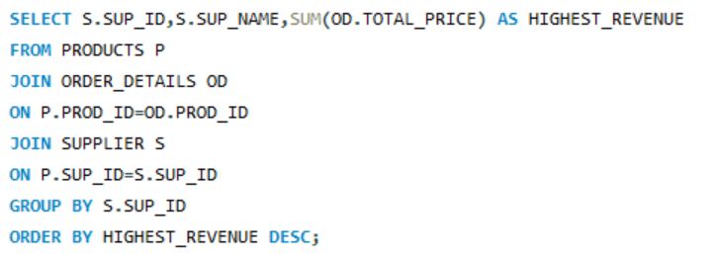
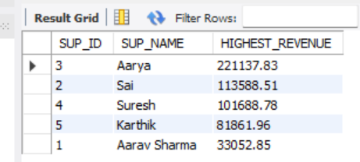
Which supplier generated the highest sales revenue through its products?

Slide 10
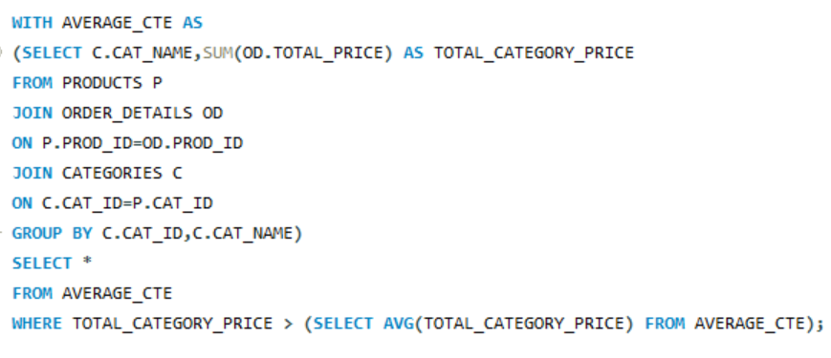
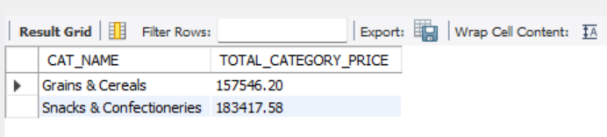
Using a CTE, find categories whose sales revenue is above the average category revenue.

Slide 11
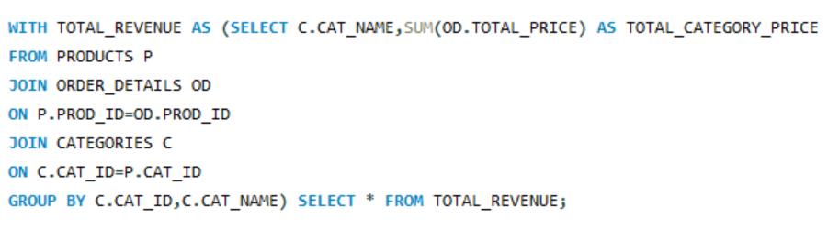
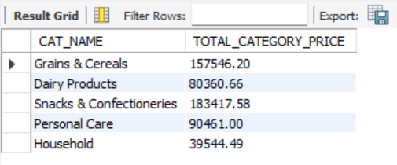
Using a CTE, calculate the total sales revenue of each category.

Slide 12
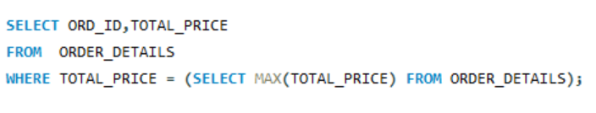
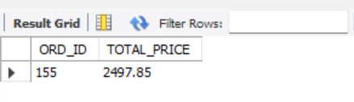
Find the highest-value order.

Slide 13
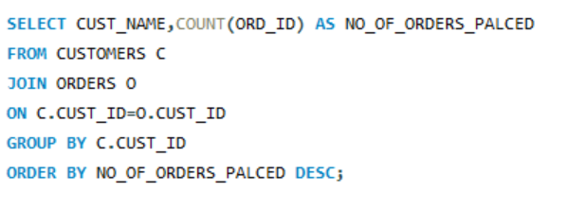
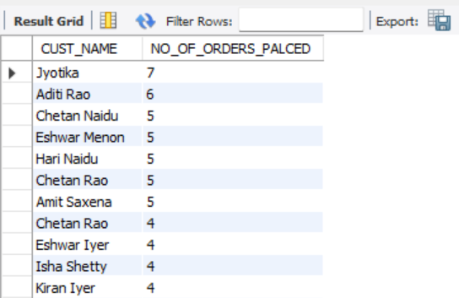
Find the customers who placed the most orders.

Slide 14
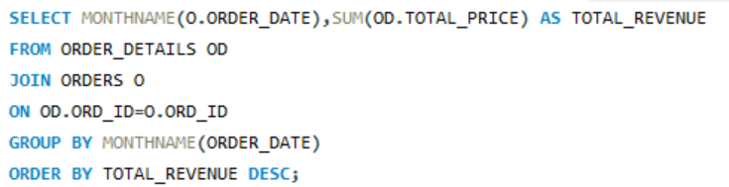
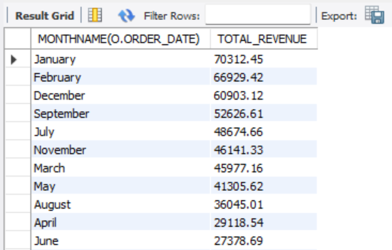
Calculate the total sales revenue for each month.

Slide 15
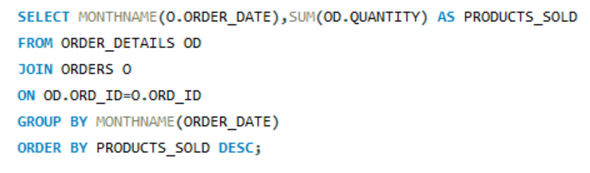
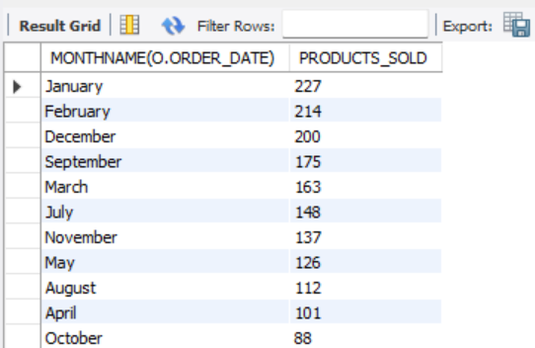
Find the month with the highest number of products sold.

Slide 16
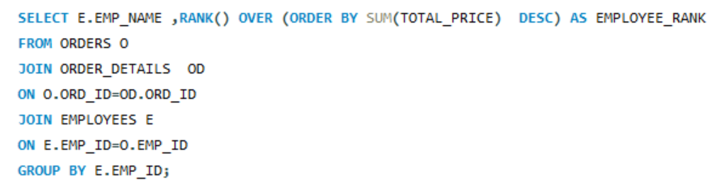
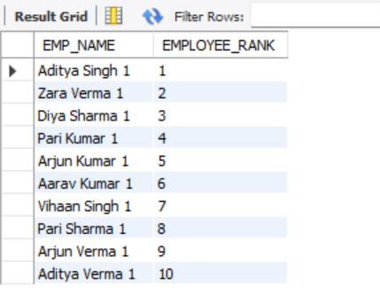
Rank employees based on total sales revenue

Slide 17
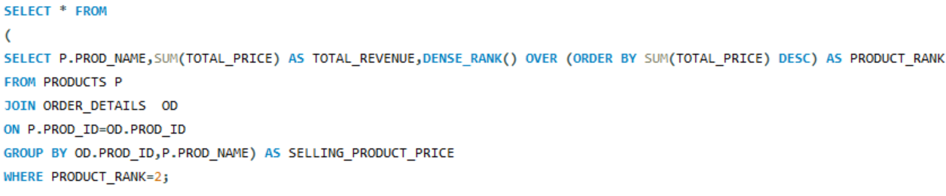
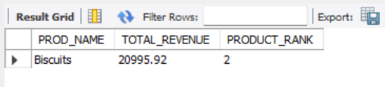
Which product has the second highest sales revenue?

Slide 18
KEY INSIGHTS
Category Performance
Identified the product categories that generated the highest sales revenue, helping the store understand which categories contribute the most to overall sales.
Supplier Contribution
Analysed supplier performance by identifying suppliers whose products generated the highest sales revenue, enabling better supplier evaluation.
Customer Purchasing Behavior
Identified customers who placed the highest number of orders, helping the business recognize its most active customers.
Monthly Sales Trends
Analysed monthly sales revenue and the number of products sold each month to identify sales patterns and business trends over time.
Employee Performance
Ranked employees based on the total sales revenue they processed, helping evaluate employee performance and operational efficiency.

Slide 19
Challenges
Resolving date format issues while importing CSV data into MySQL.
Analysing sales data by applying SQL concepts such as joins, CTEs, subqueries, and window functions.
Experience
Gained practical experience in database design and SQL-based sales analysis.
Improved my ability to solve real-world business problems using data-driven insights.

Slide 20
CONCLUSION
This project successfully analyses the sales performance of a grocery store using SQL. By identifying customer purchasing behaviour, best-selling products, monthly sales trends, supplier contributions, and employee performance, the project provides valuable insights that support data-driven business decisions and help improve sales and profitability.

Slide 21

THANK
YOU

